Slide 1
Resume Classification
A Machine Learning Approach for Automating Resume Categorization

Slide 2
Objective:
Automate the classification of resumes into predefined categories such as PeopleSoft, SQL Developer, React Developer, and Workday.
To significantly reduce the manual human effort in the HRM and reduce human intervention.
Motivation:
Sorting and ranking resumes manually is time-consuming and prone to errors.
Automating the process improves efficiency and ensures higher accuracy and consistency in hiring workflows.

Slide 3
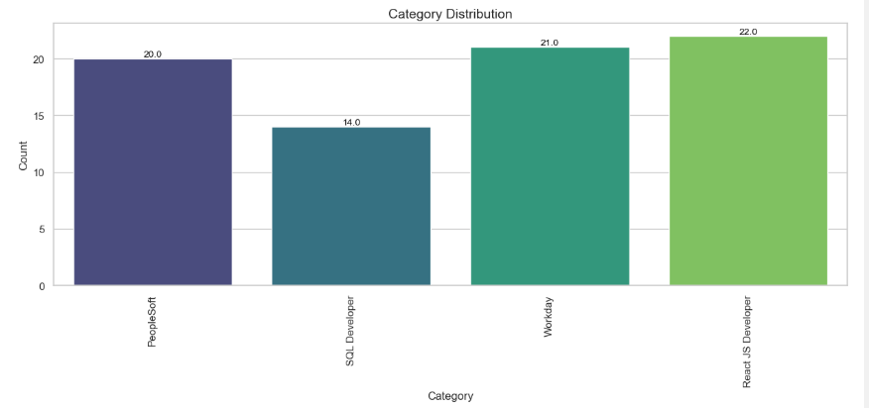
Dataset Overview:
Number of resumes: 79
Categories: PeopleSoft, SQL Developer, React Developer, Workday
Formats: Text extracted from DOCX, PDF, and TXT files

Slide 4
Methodology Overview
Data Collection
Extract raw data from resume and address data anomalies
EDA
Analyze patterns in resume content and explore insights across categories
Feature Engineering
Applied TF-IDF to convert text into numerical features
Model Building
Evaluate multiple machine learning models for classification
Model Evaluation
Asses the performance of models using various metrics
Deployment
Deploy a user-friendly interface for classification and resume parsing

Slide 5
Data Collection
Collected a dataset of resumes classified into predefined categories (e.g., PeopleSoft, SQL Developer, etc.).
Addressed missing values, duplicate entries, and standardized formatting.
Prepared the data for analysis by cleaning and organizing the text data.

Slide 6
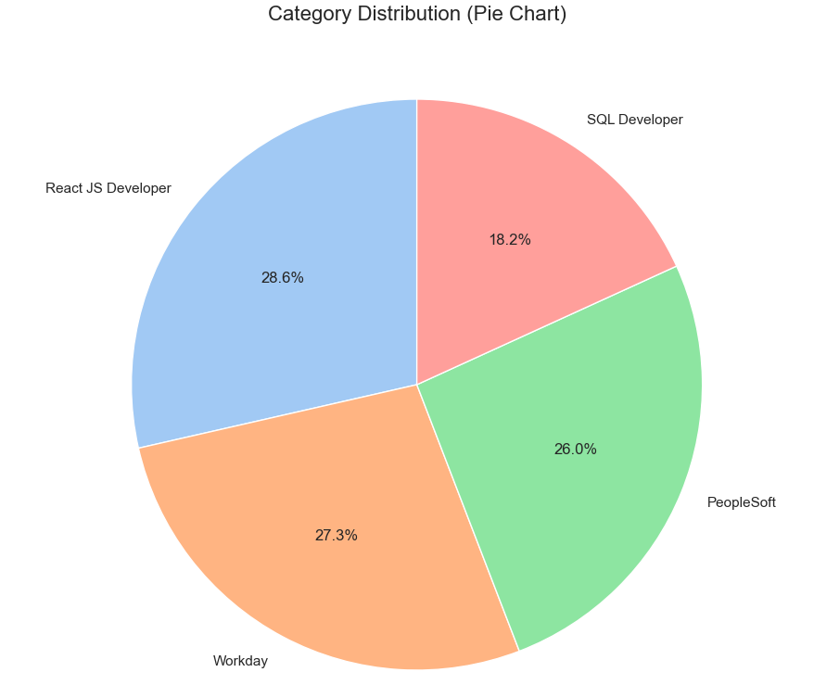
Exploratory Data Analysis (EDA)
Analyzed patterns in resume content across categories.
Identified key terms, most frequent skills, and possible class imbalances.
Visualizations included:
Pie chart showing the percentage of resumes per category

Slide 7
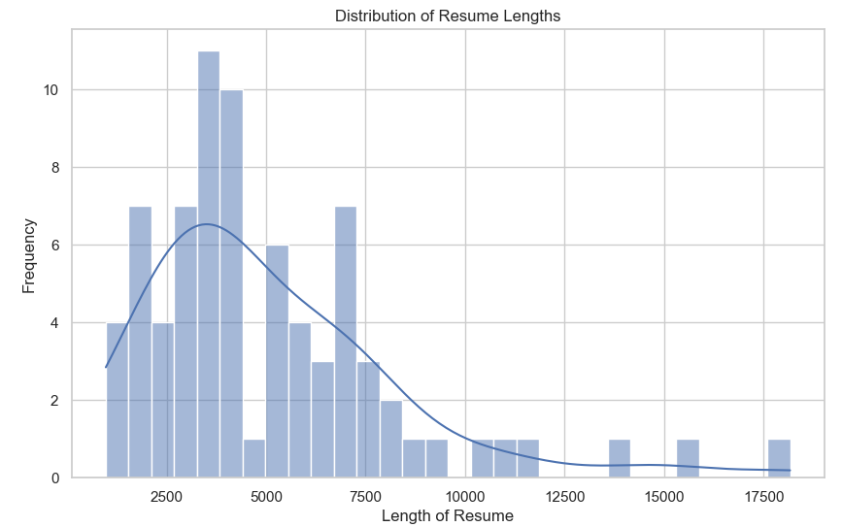
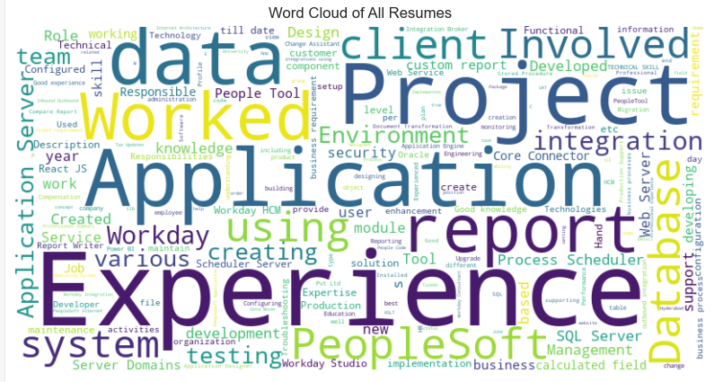
Visualizations included:
Distribution of Resume lengths
Word cloud for most common terms.

Slide 8
Data Preprocessing and Feature Engineering
Example:
Raw Resume Text: "John Doe, SQL Developer, 5 years of experience in database management, proficient in Python.“
Processed Text: "john doe sql developer years experience database management proficient python.".
Text Preprocessing Steps:
Converted text to lowercase
Removed punctuation, special characters, and stop words.
Tokenized words for further processing
Feature Engineering:
Used TF-IDF vectorization to capture the importance of words relative to their frequency across resumes.

Slide 9
Models Building
We tested multiple learning models for classification:
Logistic Regression: Baseline model for fast and interpretable predictions.
K-Nearest Neighbor (KNN): Predicted classes based on the nearest neighbors.
Support Vector Machines (SVM): Found the optimal boundary for class separability.
Random Forest: Combined multiple decision trees for robust predictions.
Light Gradient Boosting Machine (LGBM): Builds an ensemble of decision tree, where each tree attempts to correct the error made by previous one.
Why Multiple Models?
To compare performance and select the best model for accurate classification.

Slide 10
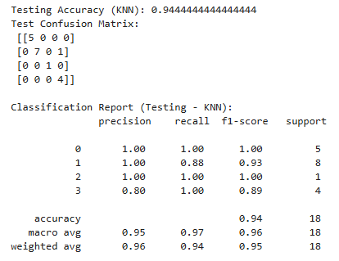
Results and Evaluation
Evaluation Metrics:
Accuracy: Percentage of correct prediction.
Precision: How many predicted resumes are correct.
Recall: How many actual resumes are identified.
F1-Score: Combines precision and recall for balanced evaluation.
Key Results
Best Model : KNN
Test Accuracy : 94%
This models avoids overfitting and is efficient for resume classification.

Slide 11
Deployment and Parsing
Example
Skills: JavaScript, Python, React
Experience: 5 years
Education: Masters
Scores
Skills: 3*0.4 = 1.2
Experience: 5*0.4 = 2.0
Education: 2*0.2 = 0.4
Total Score: 1.2+2.0+0.4 = 3.6
Built a user-friendly interface for real-time resume classification.
Parsed resume to extract key attributes
Algorithm
Each resume is ranked based on three factors:
Skills: 40%
Experience: 40%
Education: 20% (PhD > Masters > Bachelor)
calculate a weighted score for ranking resumes within categories.

Slide 12
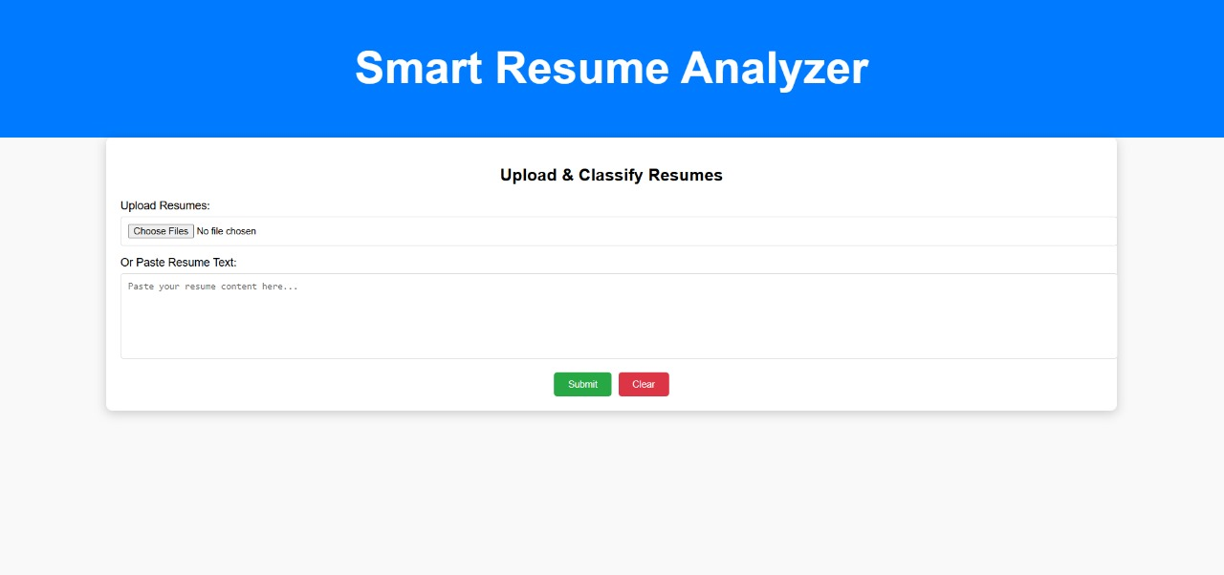
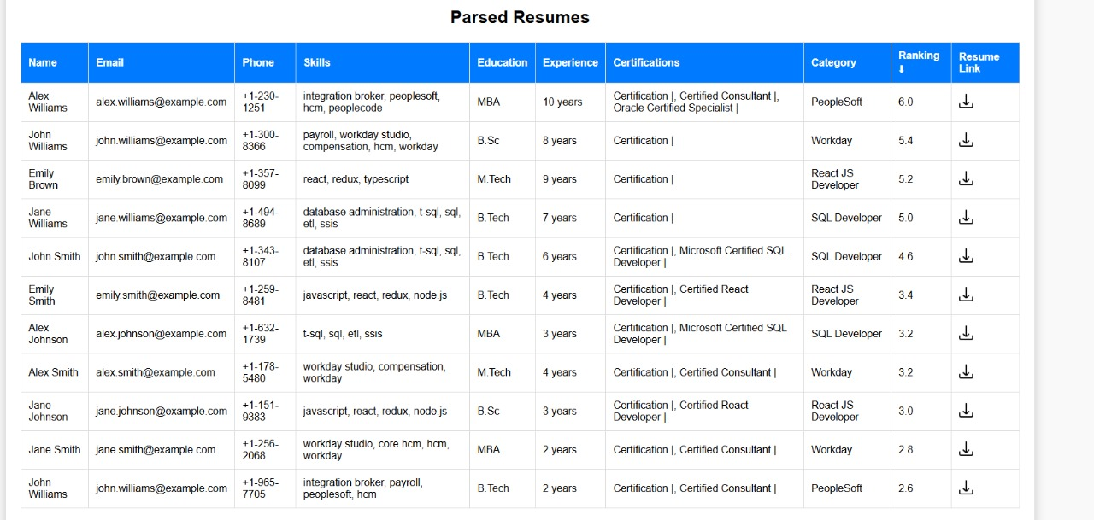
Smart Resume Analyzer

Slide 13
Challenges Faced
Parsing Unstructured Data: Resumes had varying formats, making feature extraction complex.
Imbalanced Categories: Some categories had fewer resumes, affecting model performance.
Overfitting Risks: Small dataset size led to challenges in generalization.
High-Dimensional Data: TF-IDF features created a very large feature space.

Slide 14
Conclusion and Future Work
Conclusion:
Successfully automated resume classification into predefined categories with an accuracy of 94% using KNN model.
Designed a ranking mechanism to identify top resumes within each category.
Future Work:
Scale the dataset for better generalization and diversity.
Integrate the system into a real-time platform with an interactive user interface.

Slide 15
Thank You!
By:
Prathamesh Joshi
Sourabh Kumar
Ganji Sahithi
Krishnarani Mallick
Snehal Jagtap
Aishwarya Tiwari
Thank you for your attention! Please feel free to ask any questions.

